Slide 1

Introduction to R Women in Data 2017
Jelena Ilic, Beth Ashlee
Twitter: @MangoTheCat
Email: info@mango-solutions.com
Introduction to R – Women in Data 2017

Slide 2
Code For Today
bit.ly/tttt
bit.ly/hhh
Introduction to R – Women in Data 2017

Slide 3
Agenda
Introduction to R
Reading in datasets
Manipulating datasets
Data visualisations
Bonus material: simple statistics
Introduction to R – Women in Data 2017

Slide 4
Introduction to R
Free, open source implementation of the "S" language
Originally written by Robert Gentleman and Ross Ihaka of the University of Auckland
R has many contributors from all over the world - CRAN is the main public package repository
Over 10,000 packages available for download
Introduction to R – Women in Data 2017

Slide 5
R and R Studio
R can be installed directly from “CRAN” (Comprehensive R Archive Network)
Accessible from the R project website
www.r-project.org
From this site, users can download either the more recent release or previous releases
The RStudio product can be installed from the RStudio company website
http://www.rstudio.com
There are desktop and server version available
Introduction to R – Women in Data 2017

Slide 6

Reading in datasets
Introduction to R – Women in Data 2017

Slide 7
Reading in datasets
Set the working directory in R to folder containing your dataset
setwd(“<location of your dataset>”)
Use the following functions to read the datasets
Data file type | Function | Library
.txt | read.table(“<filename.txt>”, header = TRUE) | native
.csv | read.csv(file=“<filename.csv>", header=TRUE, sep=",") | native
.xls | read.xls (“<filename.xls>"), sheet = 1, header = TRUE) | gdata
.xlsx | read.xlsx (“filename.xlsx"), sheet = 1, header = TRUE) | xlsx

Slide 8

Data manipulation
Introduction to R – Women in Data 2017
Notes:
The image is from https://pixabay.com/en/wood-tools-plyers-iron-axe-2628286/
Free for commercial use No attribution required

Slide 9
Merge two datasets
Merge two datasets horizontally – must have a common variable
Merge two datasets vertically – all variables in the two datasets must be the same
> # merge two data frames by ID > total <- merge(dfA, dfB, by="ID")
> # add rows from dfB to dfA > total <- rbind(dfA, dfB)
Introduction to R – Women in Data 2017

Slide 10
Data manipulation – dplyr
The dplyr package provides a general framework for manipulation of data frames in R (written by Hadley Wickham) it provides the following functions:
filter
select
arrange
mutate
Summarise
These functions all work in a similar fashion:
The first argument is a data frame
The remaining arguments describe what to do to the data frame
The function always returns a data frame
Introduction to R – Women in Data 2017

Slide 11
The filter function
The filter function allows us to select specific rows from a data frame, by specifying a logical statement:
We can filter using more than 1 logical statement, which are joined by an “&” on execution: cyl == 4 & carb == 2
To select rows where one condition or the other is satisfied we have to build the condition with the “|” symbol: cyl == 4 | carb == 2
> filter(mtcars, cyl == 4) # note double equals to test equality mpg cyl disp hp drat wt qsec vs am gear carb 1 22.8 4 108.0 93 3.85 2.320 18.61 1 1 4 1 2 24.4 4 146.7 62 3.69 3.190 20.00 1 0 4 2 3 22.8 4 140.8 95 3.92 3.150 22.90 1 0 4 2 4 32.4 4 78.7 66 4.08 2.200 19.47 1 1 4 1 ...
Introduction to R – Women in Data 2017

Slide 12
The select function
The select function allows us to choose the columns to retain within a dataset. We use the function by specifying the column names:
We can also specify a column order, for example using mpg:hp to select columns mpg, cyl, disp and hp.
> select(mtcars, mpg, cyl, wt) # select 3 columns mpg cyl wt Mazda RX4 21.0 6 2.620 Mazda RX4 Wag 21.0 6 2.875 Datsun 710 22.8 4 2.320 Hornet 4 Drive 21.4 6 3.215 ...
Introduction to R – Women in Data 2017

Slide 13
The arrange function
The arrange function allows us to sort the data on 1 or more variables.
We provide values which specify the variables by which to sort in ascending order.
> arrange(mtcars, mpg) mpg cyl disp hp drat wt qsec vs am gear carb 1 10.4 8 472.0 205 2.93 5.250 17.98 0 0 3 4 2 10.4 8 460.0 215 3.00 5.424 17.82 0 0 3 4 3 13.3 8 350.0 245 3.73 3.840 15.41 0 0 3 4 4 14.3 8 360.0 245 3.21 3.570 15.84 0 0 3 4 ...
Introduction to R – Women in Data 2017

Slide 14
The mutate function
We can create new variables within a data frame using the mutate function.
Using this function we can specify new variables:
> mutate(mtcars, pwr2wt = hp/wt) mpg cyl disp hp drat wt qsec vs am gear carb pwr2wt 1 21.0 6 160.0 110 3.90 2.620 16.46 0 1 4 4 41.98473 2 21.0 6 160.0 110 3.90 2.875 17.02 0 1 4 4 38.26087 3 22.8 4 108.0 93 3.85 2.320 18.61 1 1 4 1 40.08621 4 21.4 6 258.0 110 3.08 3.215 19.44 1 0 3 1 34.21462 ...
Introduction to R – Women in Data 2017

Slide 15
The mutate function
One of the nice features of the mutate function is that we can create columns that depend on each other without having to write multiple steps.
> mutate(mtcars, pwr2wt = hp/wt, pwr2wt.Sq = pwr2wt^2) mpg cyl disp hp drat wt qsec vs am gear carb pwr2wt pwr2wt.Sq 1 21.0 6 160.0 110 3.90 2.620 16.46 0 1 4 4 41.98473 1762.7178 2 21.0 6 160.0 110 3.90 2.875 17.02 0 1 4 4 38.26087 1463.8941 3 22.8 4 108.0 93 3.85 2.320 18.61 1 1 4 1 40.08621 1606.9040 4 21.4 6 258.0 110 3.08 3.215 19.44 1 0 3 1 34.21462 1170.6402 ...
Introduction to R – Women in Data 2017

Slide 16
Summarising Data – Numeric Columns
Often when analyzing a dataset we want to calculate various summary statistics.
With dplyr we can use the summarise function to help you do that.
Typical functions we may wish to use include:
Standard summaries such as:
Additional functions provided by dplyr: n, n_distinct
Sums of logicals, such as sum(x >10)
Function | Use
mean | Mean
min | Minimum
var | Variance
sum | Sum of values
Function | Use
median | Median
Max | Maximum
Sd | Standard Deviation
Length | Length of values
Introduction to R – Women in Data 2017

Slide 17
Summarising Data – Numeric Columns
> summarise(mtcars, mean(mpg), n_distinct(cyl)) mean(mpg) n_distinct(cyl) 1 20.09062 3 > # specifying the column names > summarise(mtcars, MPG = mean(mpg), NCyls = n_distinct(cyl)) MPG NCyls 1 20.09062 3
If we have missing data we can add an option na.rm = TRUE that will find the summary value even if there are missing values, for example:
summarise(mtcars, mean(mpg, na.rm = TRUE))
Introduction to R – Women in Data 2017

Slide 18

The Pipe operator
Introduction to R – Women in Data 2017

Slide 19
The %>% Operator
The dplyr package introduced the “pipe” or “then” operator which allows us to pass data more easily between functions.
We will illustrate this with an example of two equivalent statements:
The pipe operator makes it easier for us to work out exactly what is happening by separating out each step.
> summarise(group_by(mtcars, cyl, am), MPG = mean(mpg)) ... > # is the same as > mtcars %>% group_by(cyl, am) %>% summarise(MPG = mean(mpg)) ...
Introduction to R – Women in Data 2017

Slide 20
The %>% Operator
Notice that we are no longer giving the dataset name as the first argument to the group_by and summarise functions - the pipe operator does this
It also makes the code easier to read, the above says:
"Take the mtcars data and then group it by cyl and am and then summarise by the finding the mean mpg"
So we can easily pipe data through lots of functions all in one block of code
> mtcars %>% group_by(cyl, am) %>% summarise(MPG = mean(mpg)) ...
Introduction to R – Women in Data 2017

Slide 21
The %>% Operator
> mtcars %>% select(mpg, wt, cyl, am, gear) %>% filter(am == 0) %>% group_by(cyl) %>% summarise(mean.mpg = mean(mpg)) Source: local data frame [3 x 2] cyl mean.mpg (dbl) (dbl) 1 4 22.900 2 6 19.125 3 8 15.050
Introduction to R – Women in Data 2017

Slide 22

Data visualisation
Introduction to R – Women in Data 2017

Slide 23
Basic principles
The basic principle is to create a graphical object using one of two primary functions: qplot or ggplot. Here is an example of using qplot:
We can specify the title and labels for the graphic as follows:
> qplot (mpg, hp, data = mtcars)
> qplot (mpg, hp, data = mtcars, main = 'Horsepower Vs MPG. Data: mtcars.', xlab = 'Miles/US Gallon', ylab = 'Gross Horsepower', xlim = xRange, ylim = yRange)
Introduction to R – Women in Data 2017

Slide 24
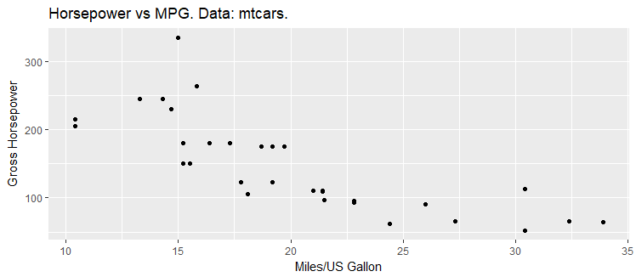
A simple scatterplot with qplot
Introduction to R – Women in Data 2017

Slide 25
A simple Bar Chart with ggplot
qplot makes a number of assumptions about what you are trying to plot. On the other hand, ggplot creates an empty graphical object that we can add layers to – it can be very useful for highly customised graphics
> basicPlot <- ggplot(data = mtcars) + geom_bar(aes( x = as.factor(cyl), y = mpg, fill = as.factor(carb)), stat = "summary", fun.y = "mean", position = "dodge")
Introduction to R – Women in Data 2017

Slide 26
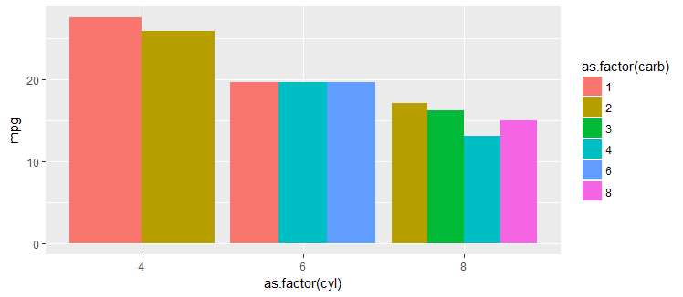
A Simple Bar Chart with ggplot
Introduction to R – Women in Data 2017

Slide 27
The Labels Layer
Use the labs function to set all labels
title, subtitle, caption
x, y
colour, fill, shape, …
> labelPlot <- basicPlot + labs(title = "Miles per gallon vs number of cylinders and carburetors", x = "Number of cylinders", y = "Miles per gallon", caption = "data: mtcars", fill = "Number of \n carburetors")
Introduction to R – Women in Data 2017

Slide 28
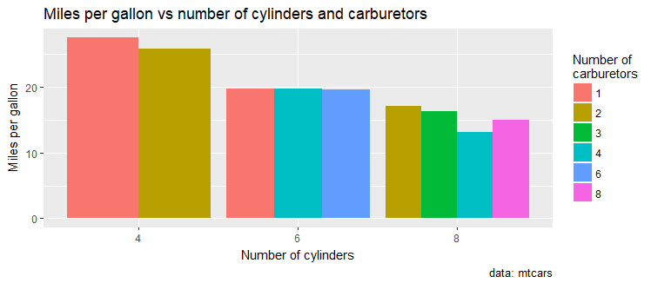
The Labels Layer
Introduction to R – Women in Data 2017

Slide 29

Simple statistics
Introduction to R – Women in Data 2017

Slide 30
Statistical models
Within R, we can fit a number of statistical models to our data. Some of the more common model fitting functions can be found in the following table:
Function | Model | Package
aov | Analysis of Variance | stats
lm | Linear regression | stats
glm | Generalised linear model | stats
gam | Generalised additive model | gam
lme | Linear mixed effects model | nlme
nls | Non-linear least squares regression | Stats
nlme | Non-linear mixed effects model | nlme
Introduction to R – Women in Data 2017

Slide 31
Linear models
A basic model can be fit by selecting a model fitting function (such as lm) and specifying a formula. Here is an example of a basic linear model fit:
We can see the contents of mpgLm using the names function
> # Fit a model of E(MPG) = a + b * Weight > mpgLm <- lm(mpg ~ wt, data = mtcars)
> #check what is in the linear model mpgLm > names(mpgLm)
Introduction to R – Women in Data 2017

Slide 32
Linear models
You can access this information by typing $ sign after the model name:
The output of the linear model contains:
> names(mpgLm) [1] "coefficients" "residuals" "effects" "rank" [5] "fitted.values" "assign" "qr" "df.residual" [9] "xlevels" "call" "terms" "model"
> coefs <- mpgLm$coefficients
Introduction to R – Women in Data 2017

